Slide 1
CENG401 MACHINE LEARNING AND ARTIFICIAL INTELLIGENCE
WEEK-7
MDP-II
Asst.Prof.Dr. Murat ŞİMŞEK

Slide 2
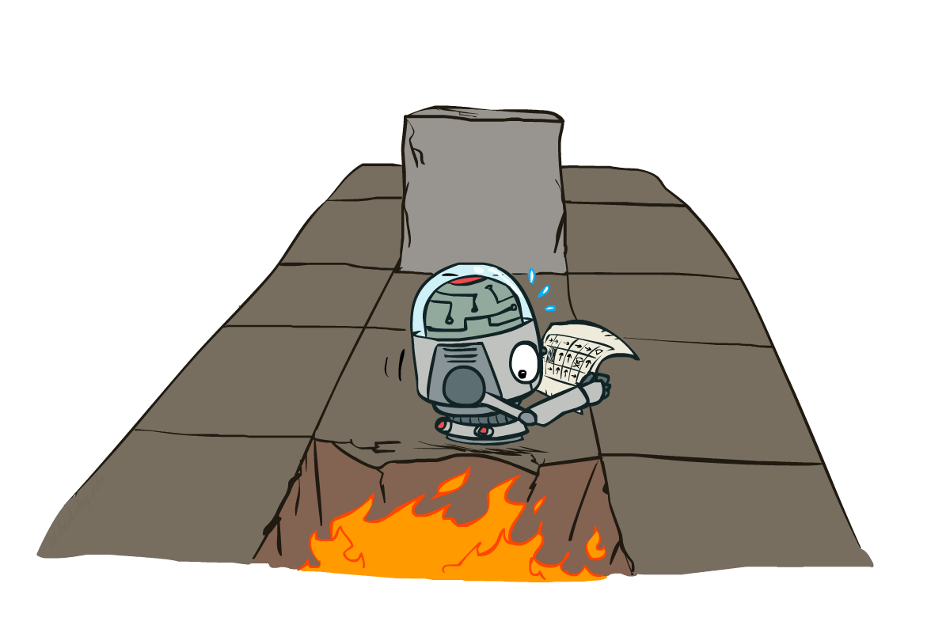
Markov Decision Processes II
Notes:
Intelligent agents are supposed to maximize their performance measure.

Slide 3
MDP Basics and Terminology
An agent must make a decision or control a probabilistic system
Goal is to choose a sequence of actions for optimality
Defined as <S, A, P, R>
MDP models:
Finite horizon: Maximize the expected reward for the next n steps
Infinite horizon: Maximize the expected discounted reward.
Transition model: Maximize average expected reward per transition.
Goal state: maximize expected reward (minimize expected cost) to some target state G.
Notes:
Intelligent agents are supposed to maximize their performance measure.

Slide 4
Recap: Defining MDPs
Markov decision processes:
Set of states S
Start state s₀
Set of actions A
Transitions P(s’|s,a) (or T(s,a,s’))
Rewards R(s,a,s’) (and discount γ)
MDP quantities so far:
Policy = Choice of action for each state
Utility = sum of (discounted) rewards
s
a
s, a
s,a,s’
s’

Slide 5
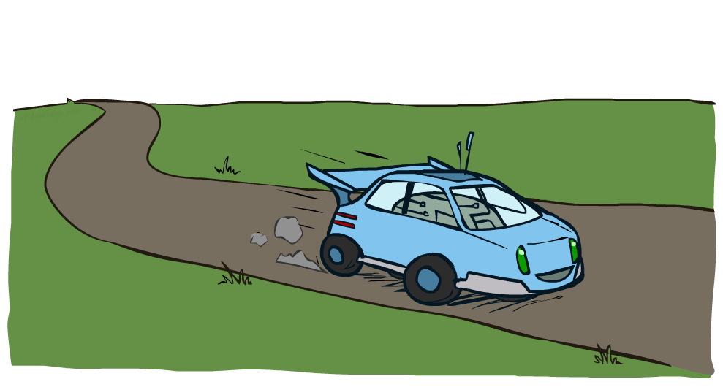
Example: Racing

Slide 6
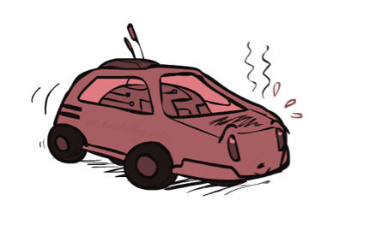
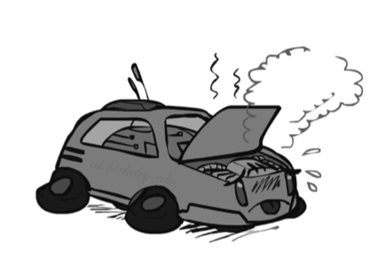

Example: Racing
A robot car wants to travel far, quickly
Three states: Cool, Warm, Overheated
Two actions: Slow, Fast
Going faster gets double reward
0.5
+1
1.0
Fast
Slow
-10
+1
0.5
Warm
Slow
Fast
0.5
+2
Cool
0.5
Overheated
+1
1.0
+2

Slide 7



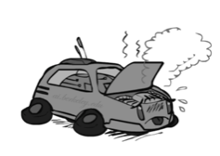
Racing Search Tree

Slide 8



MDP Search Trees
Each MDP state projects an expectimax-like search tree
s
s is a state
a
(s, a) is a q-state
s, a
(s,a,s’) called a transition
T(s,a,s’) = P(s’|s,a)
R(s,a,s’)
s,a,s’
s’
Notes:
In MDP chance node represents uncertainty about what might happen based on (s,a) [as opposed to being a random adversary]
Q-state (s,a) is when you were in a state and took an action

Slide 9
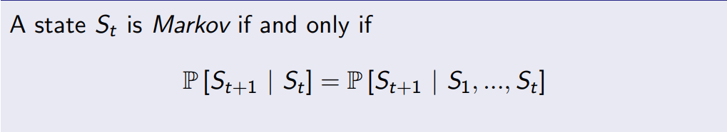
Markov Property
Notes:
Intelligent agents are supposed to maximize their performance measure.

Slide 10
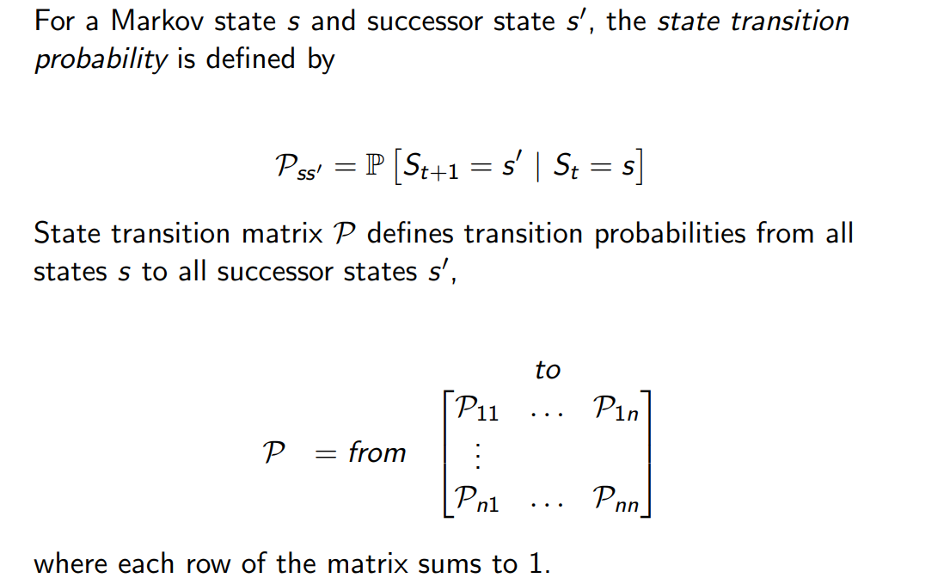
Markov Property
Notes:
Intelligent agents are supposed to maximize their performance measure.

Slide 11
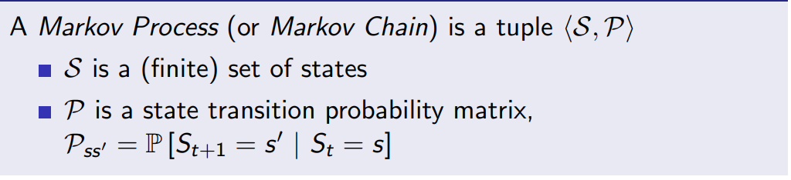
Markov Process
Notes:
Intelligent agents are supposed to maximize their performance measure.

Slide 12

Solving MDPs

Slide 13
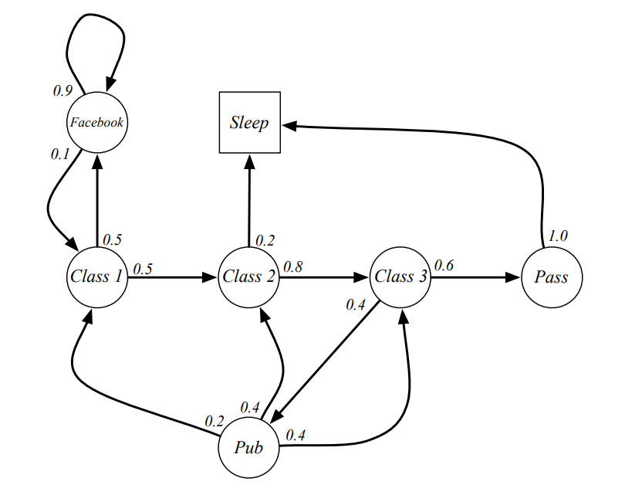
Example of Markov Chain
Find transition probability matrix.

Slide 14
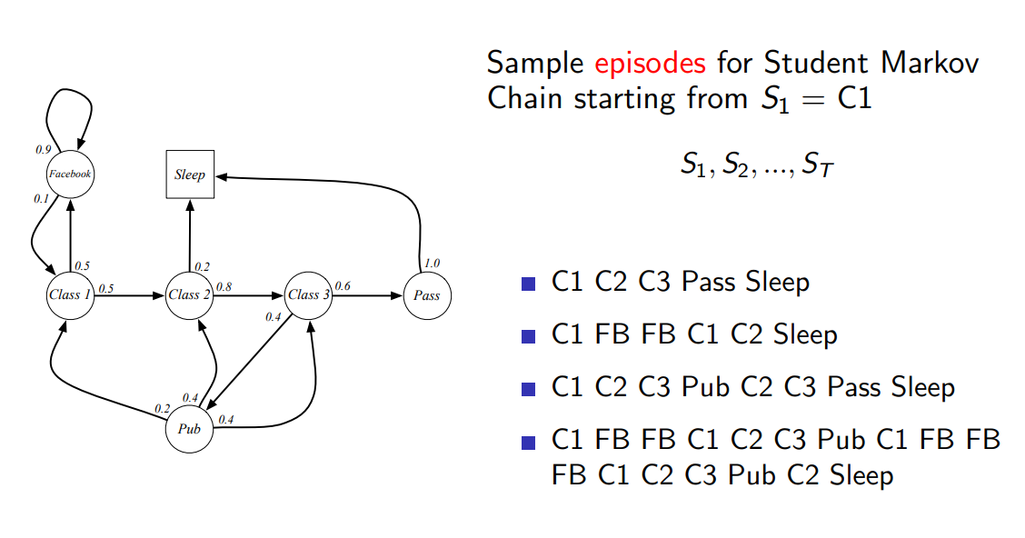
Example of Markov Chain

Slide 15
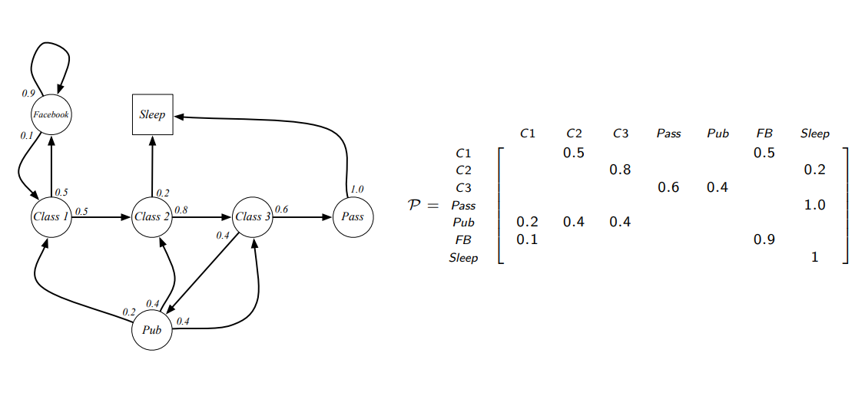
Example of Markov Chain

Slide 16
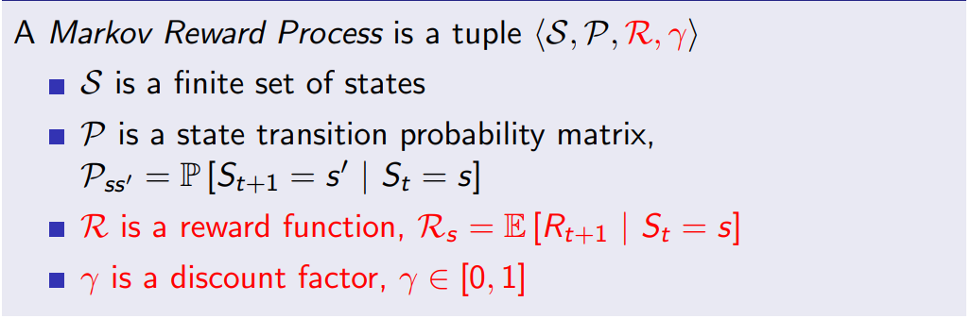
Markov Reward Process

Slide 17
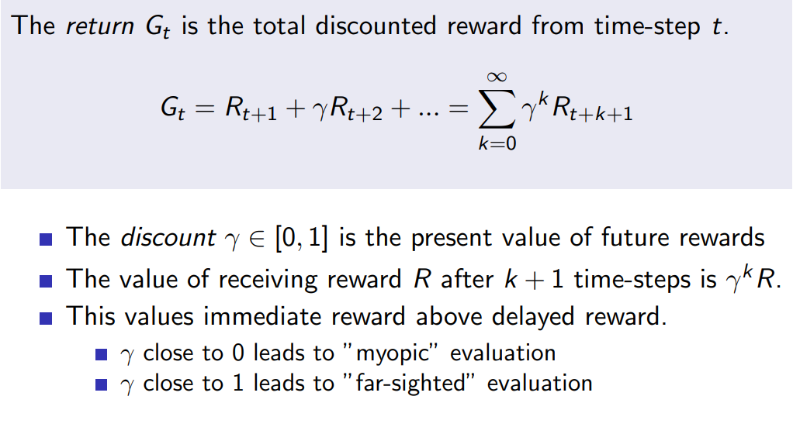
Return

Slide 18




Discounting
It’s reasonable to maximize the sum of rewards
It’s also reasonable to prefer rewards now to rewards later
One solution: values of rewards decay exponentially
Worth Now
Worth Next Step
Worth In Two Steps

Slide 19

Discounting
How to discount?
Each time we descend a level, we multiply in the discount once
Why discount?
Sooner rewards probably do have higher utility than later rewards
Also helps our algorithms converge
Example: discount of 0.5
U([1,2,3]) = 1*1 + 0.5*2 + 0.25*3
U([1,2,3]) < U([3,2,1])
Notes:
Rewards in the future (deeper in the tree) matter less
Interesting: running expectimax, if having to truncate the search, then not losing much; e.g., less then \gamma^d / (1-\gamma)

Slide 20
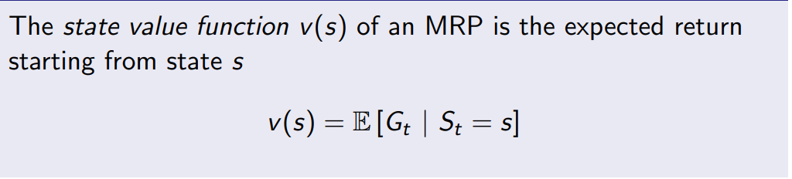
Value Function

Slide 21
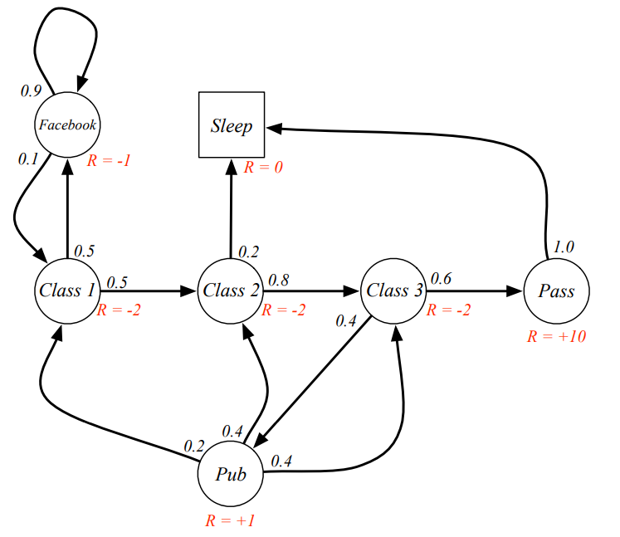
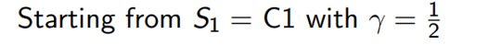
Student MRP
Calculate all value functions.

Slide 22
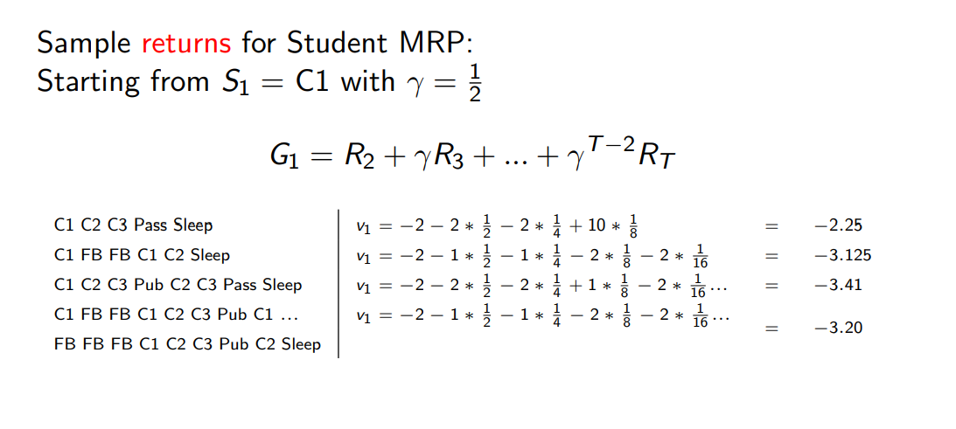
Student MRP Returns

Slide 23
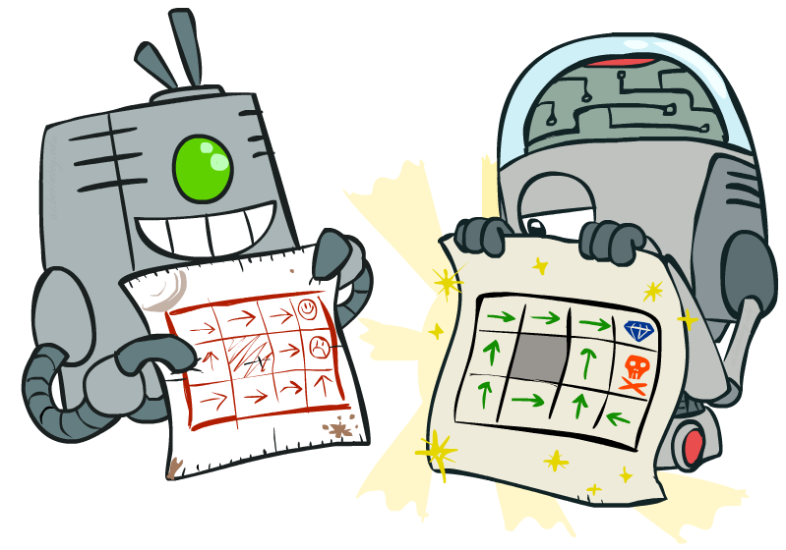
Policy Methods

Slide 24
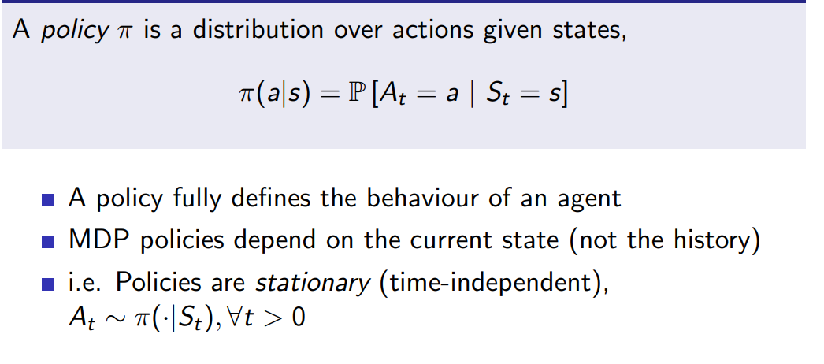
POLICIES

Slide 25
Recap: MDPs
Markov decision processes:
States S
Actions A
Transitions P(s’|s,a) (or T(s,a,s’))
Rewards R(s,a,s’) (and discount γ)
Start state s₀
Quantities:
Policy = map of states to actions
Utility = sum of discounted rewards
Values = expected future utility from a state (max node)
Q-Values = expected future utility from a q-state (chance node)
s
a
s, a
s,a,s’
s’

Slide 26

Next Week: Reinforcement Learning!

